Slide 1
REACT JS

Slide 5
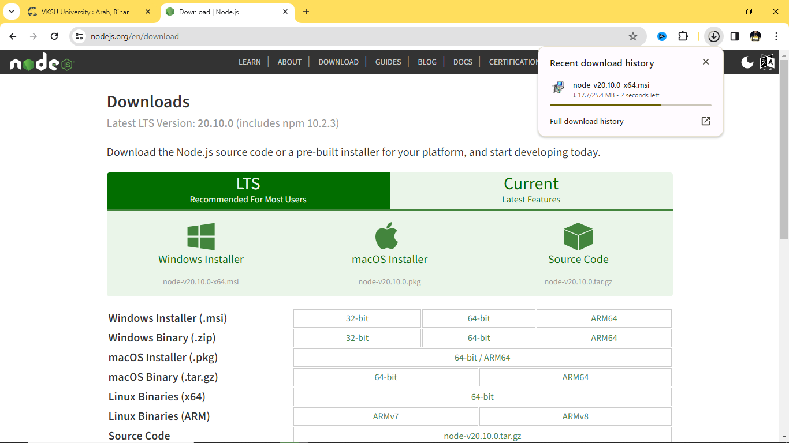

Slide 6
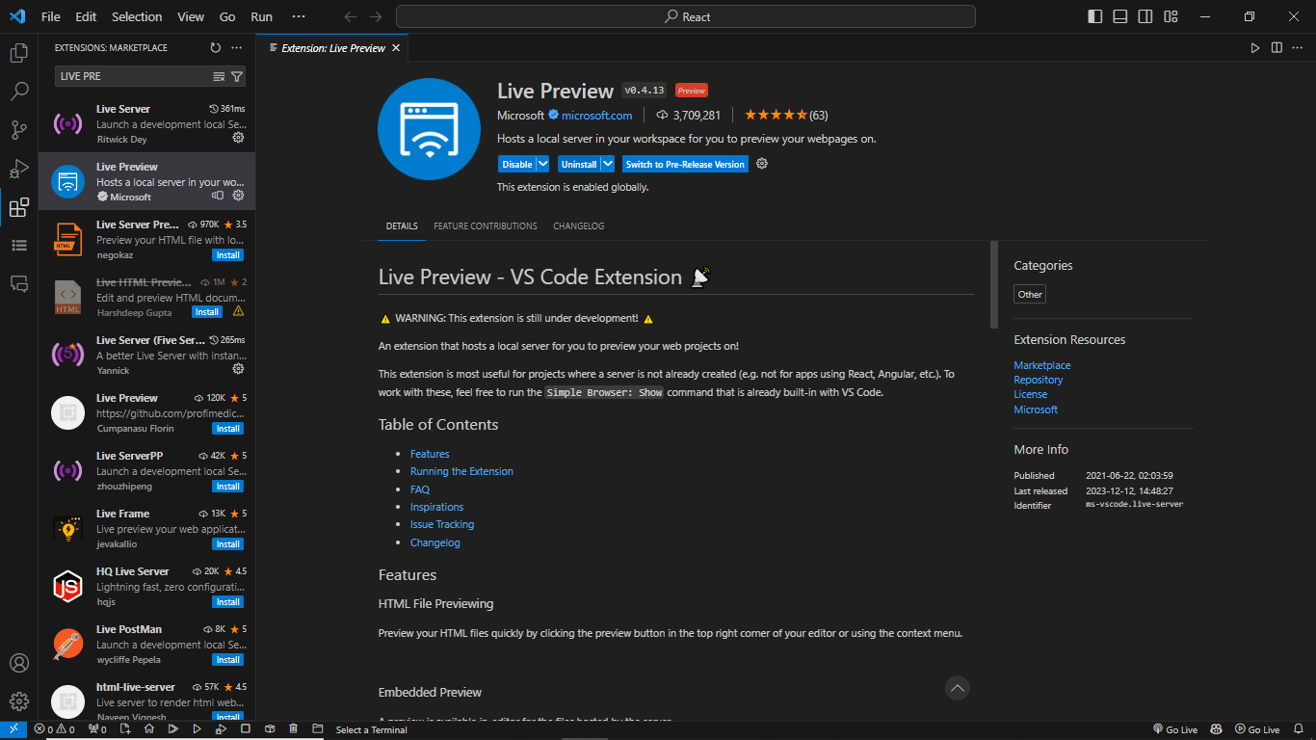
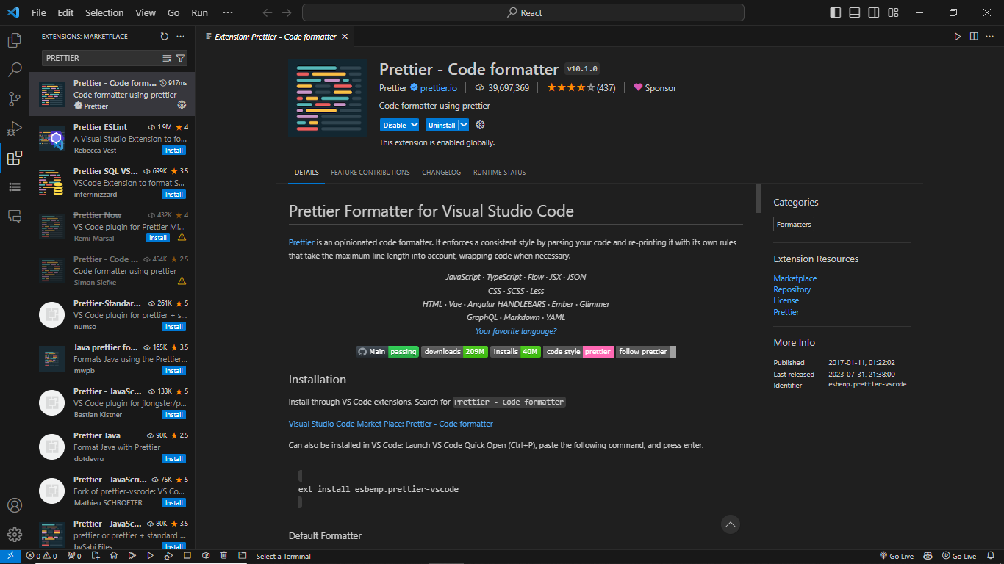
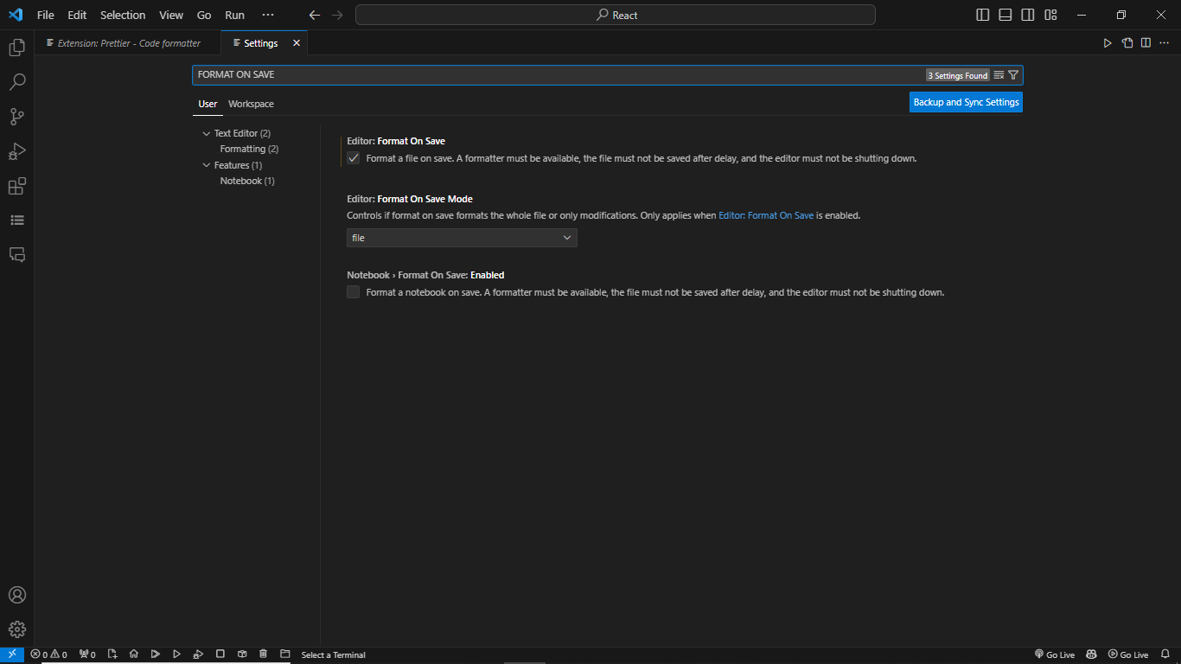

Slide 7
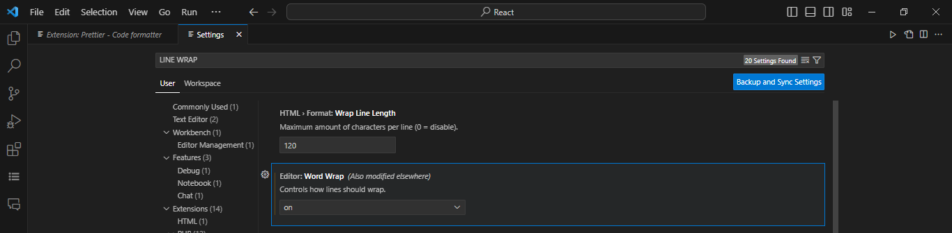
Vite:
Vite: Use npm run dev to launch dev server.
Use npm start for CRA

Slide 8
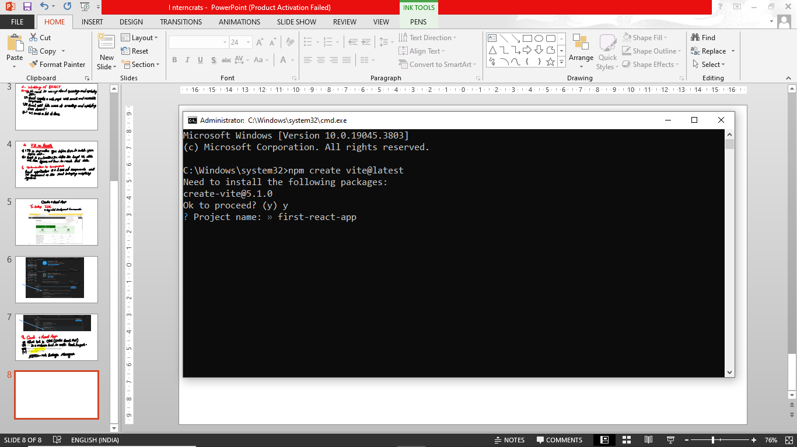

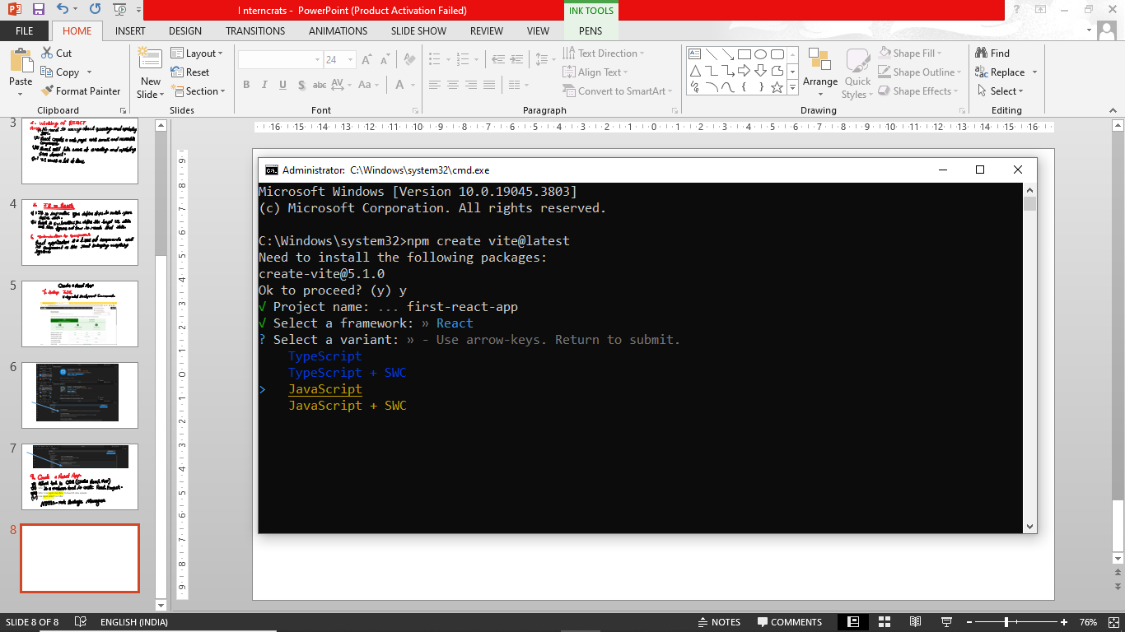

Slide 9
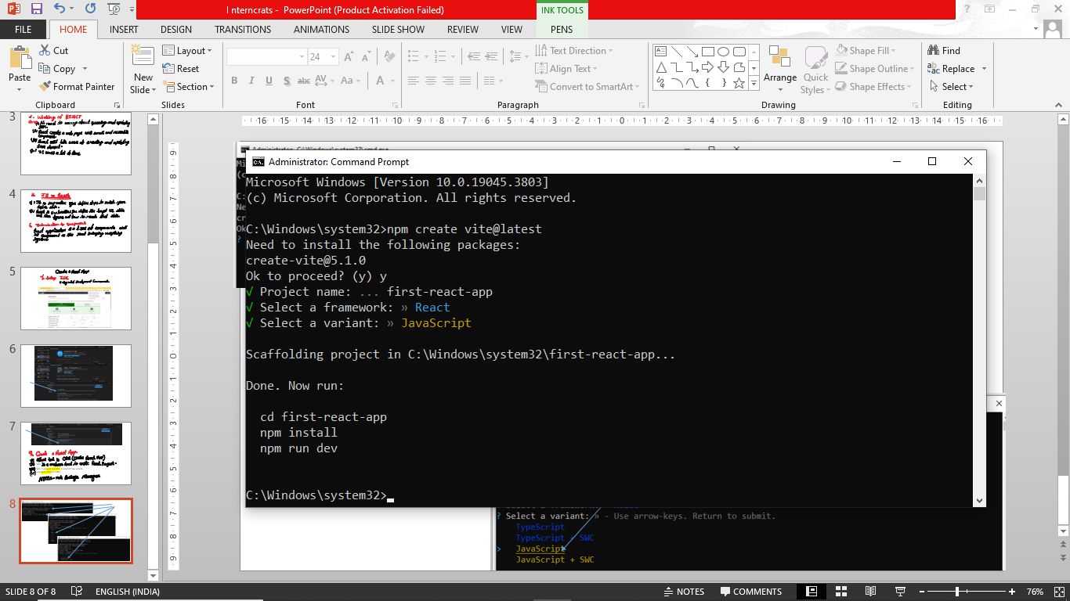
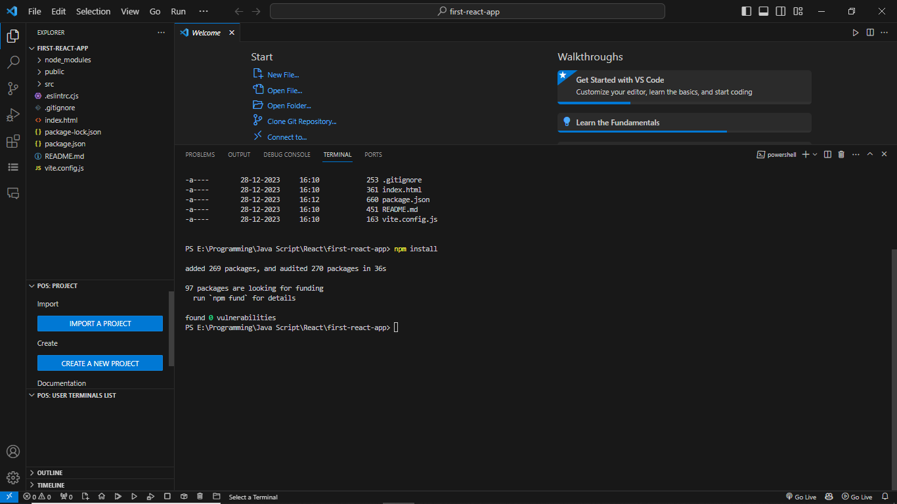
When run npm install then file will be create node_modules

Slide 10
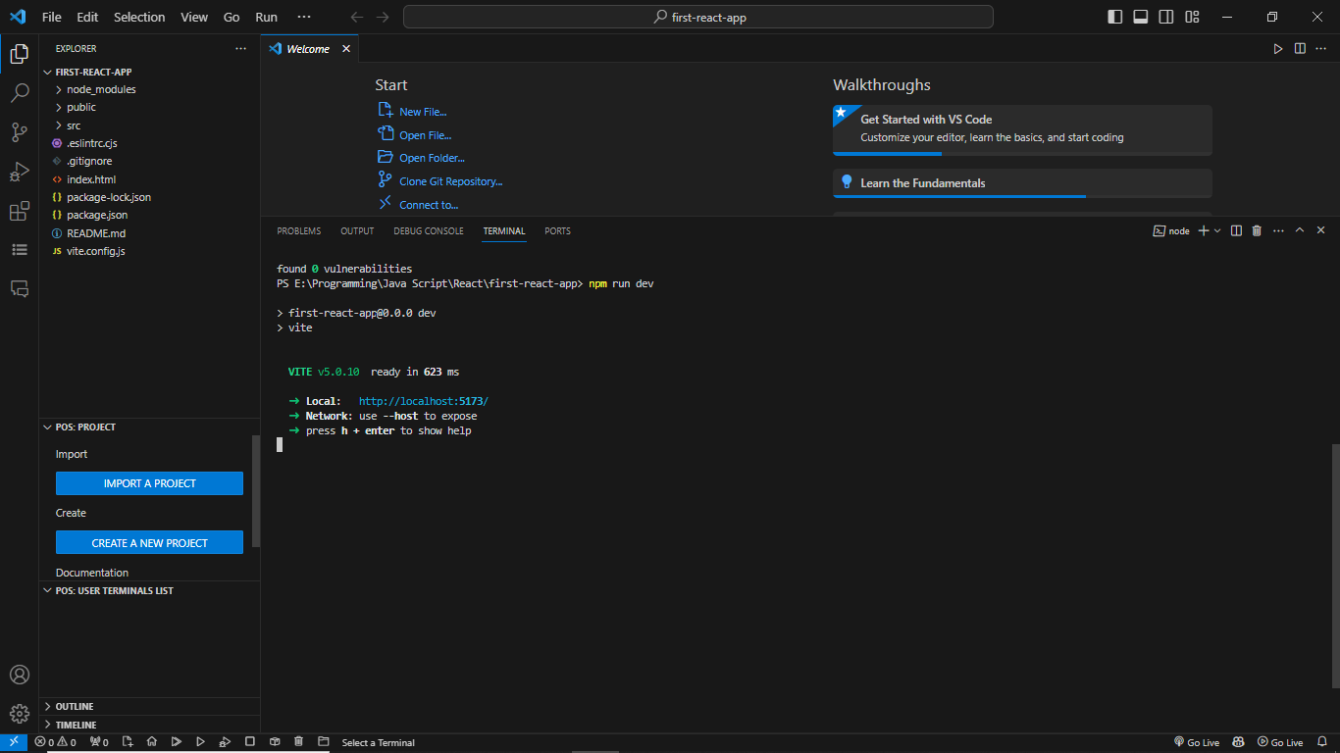
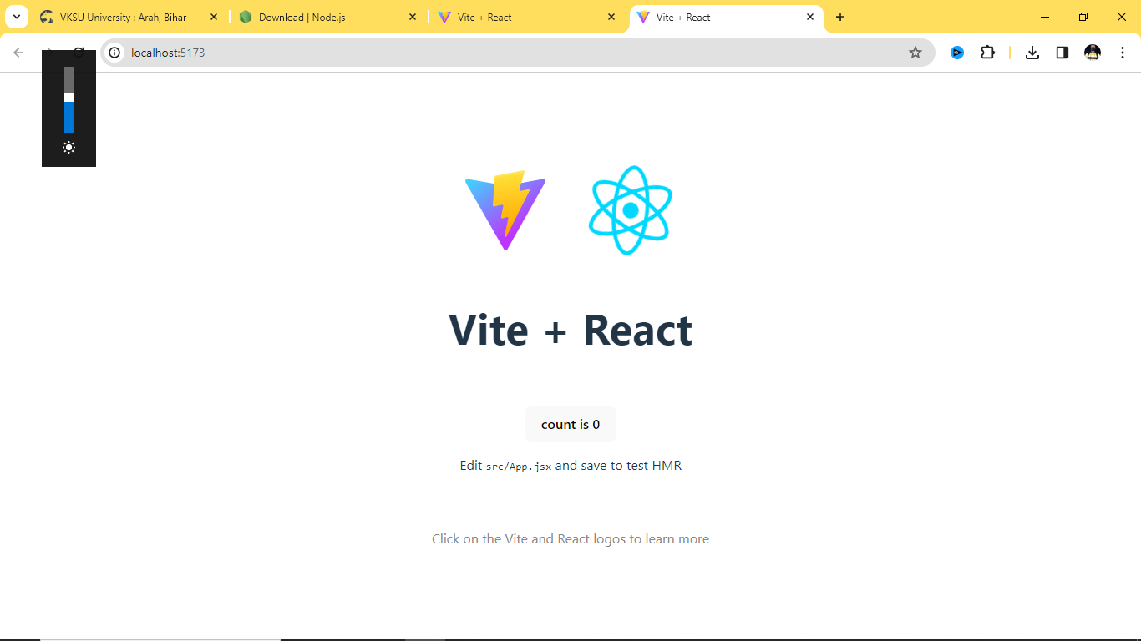
npm run dev
command
Server started
Ctrl + left click

Slide 11
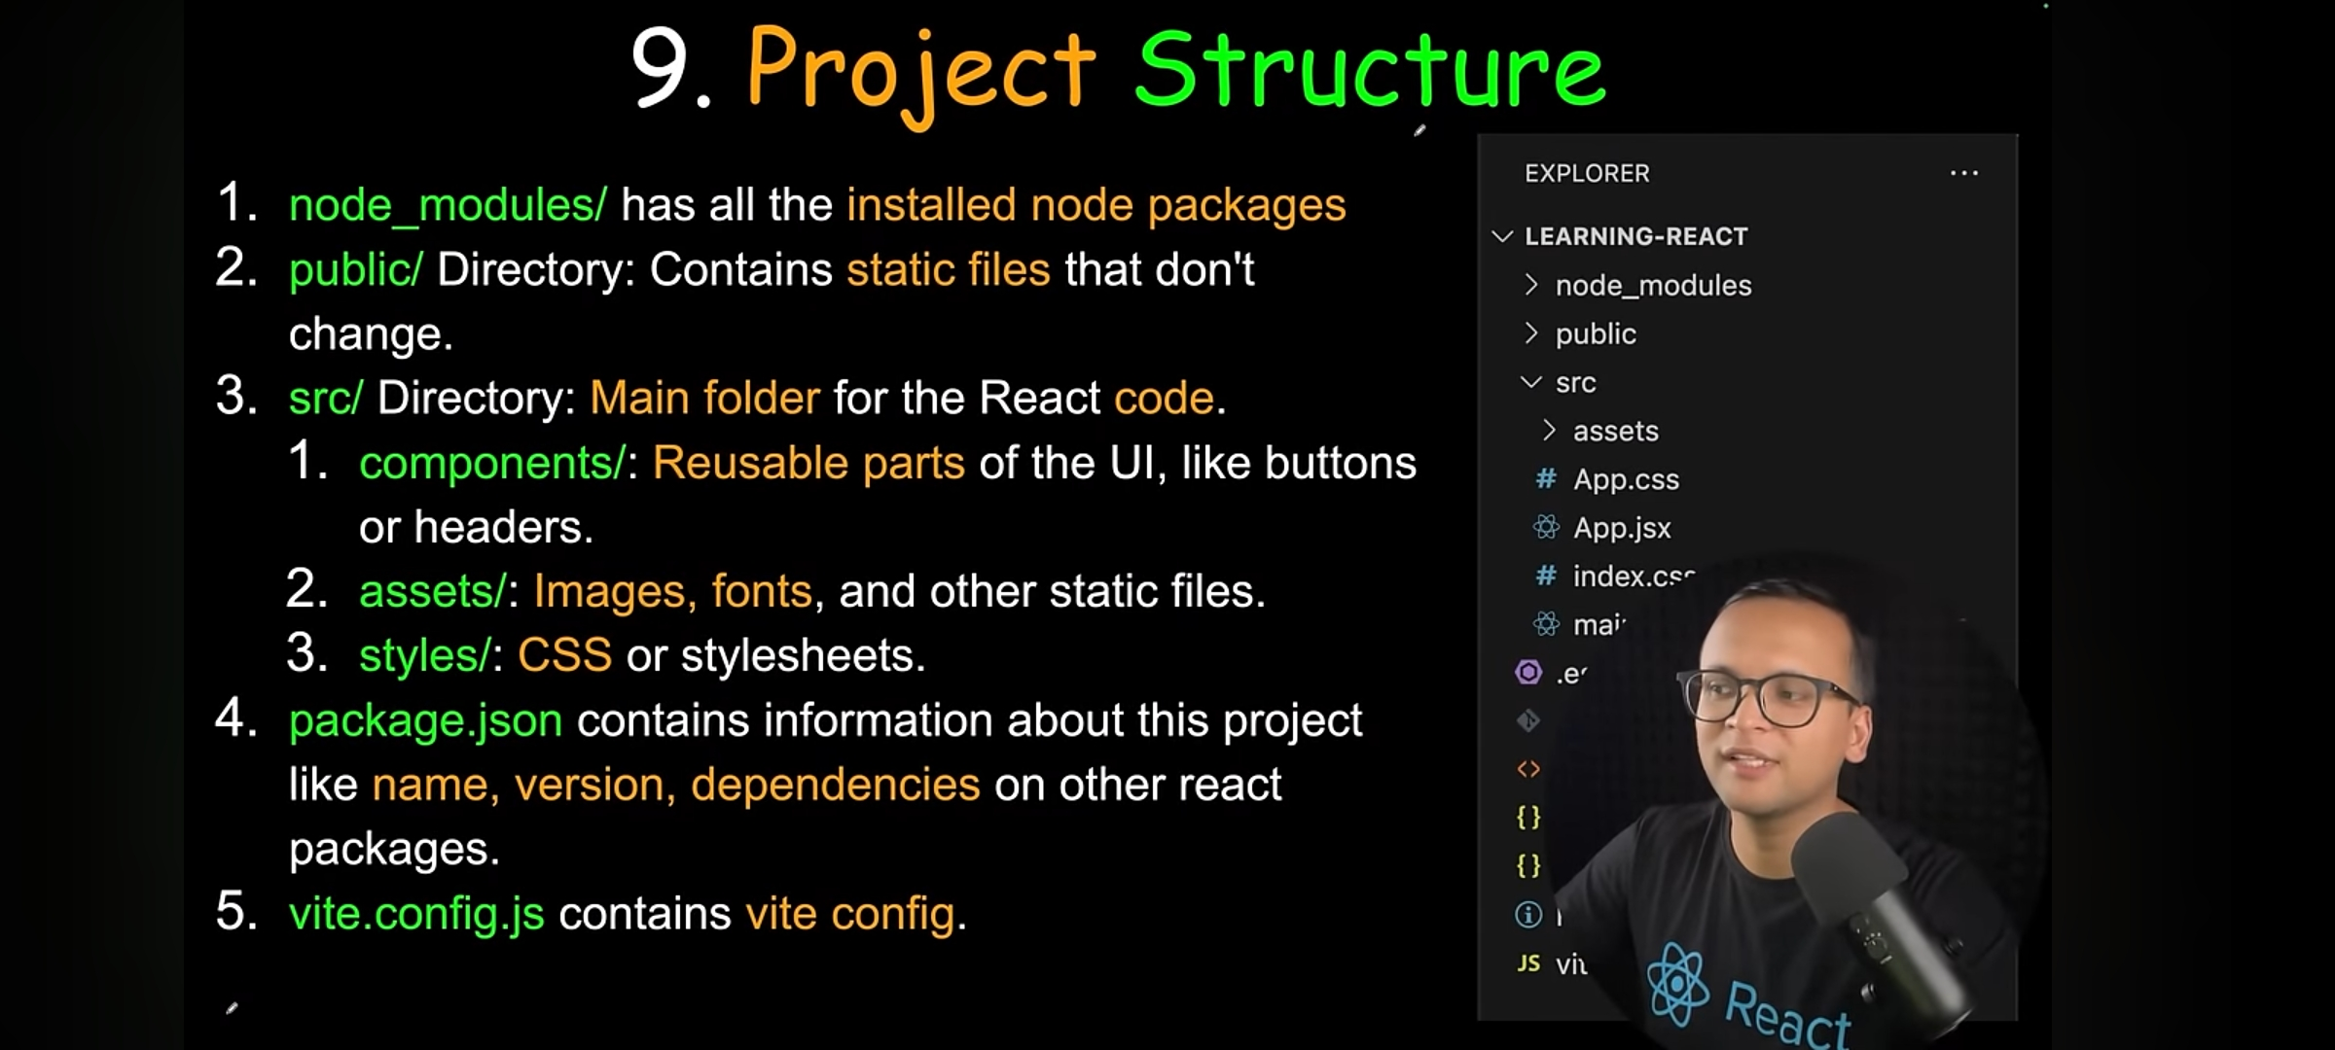

Slide 13
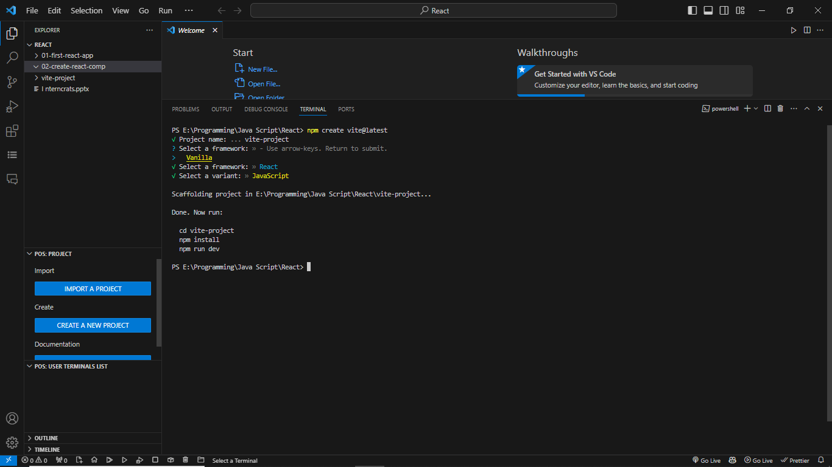

Slide 14
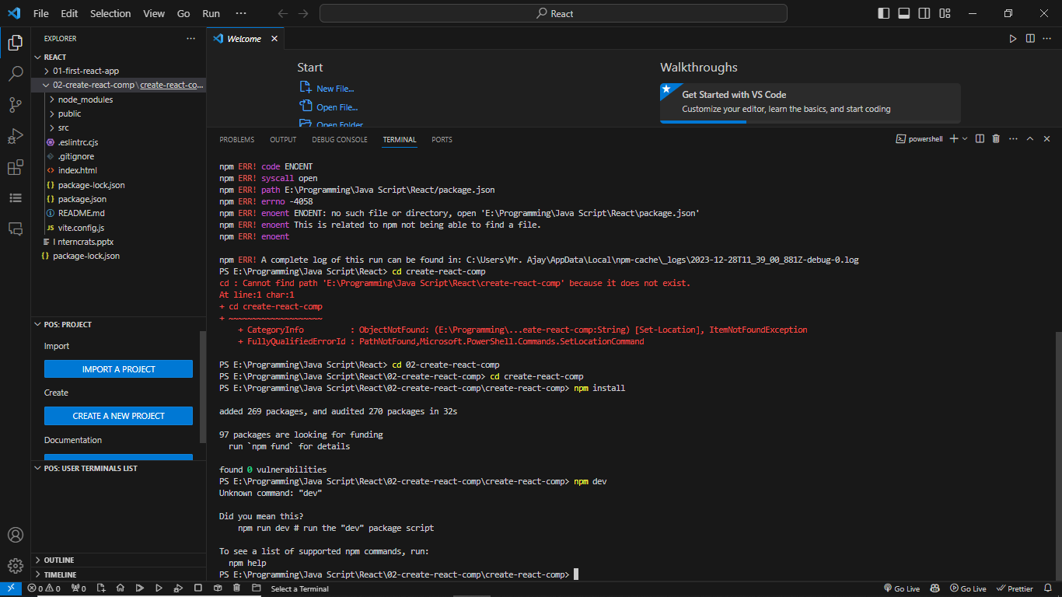

Slide 15
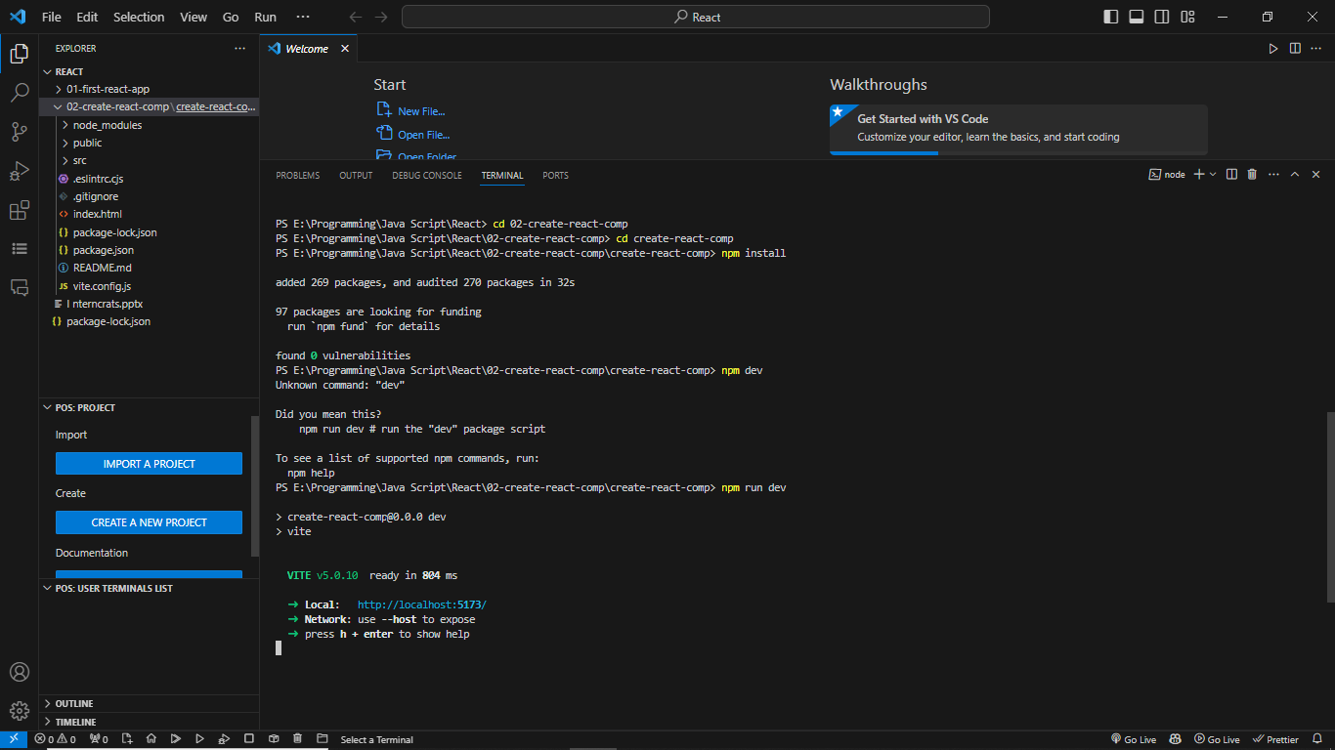

Slide 16
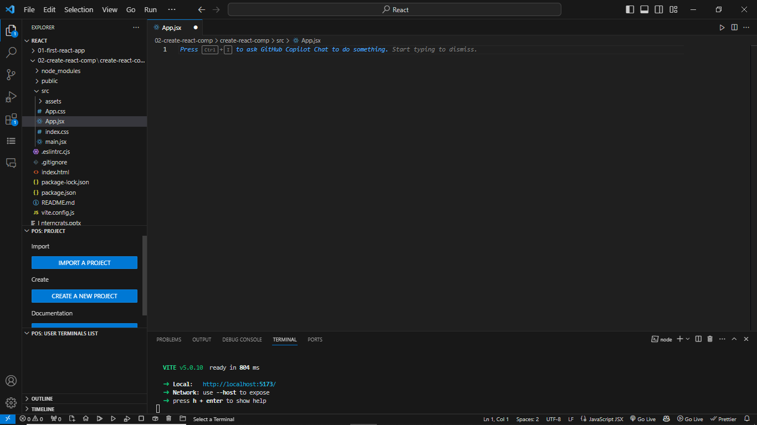
I have remove every thing from app.jsx file
29-12-2023 13:20

Slide 18
export default function Button(){
……….
}
export function Button(){
……….
}
export function Button(){
……….
}
export function Button(){
……….
}
export function Button(){
……….
}
export default function Button(){
……….
}

Slide 21
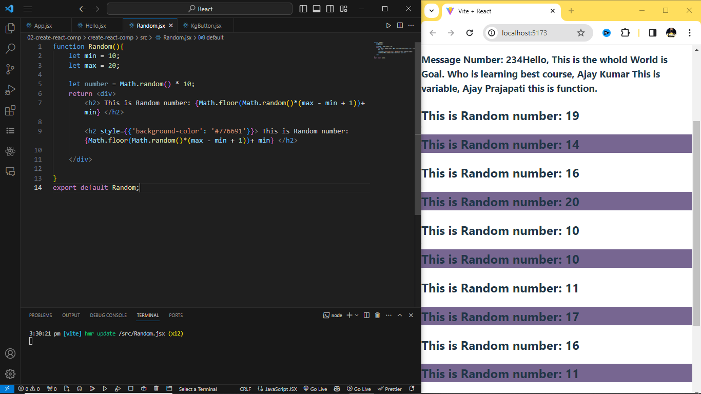
CSS Writing Syntex

Slide 22
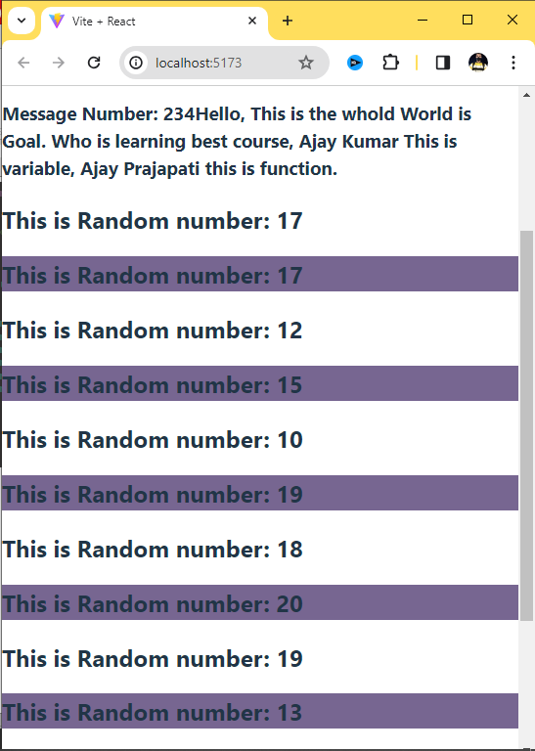
import KgButton from "./KgButton";
import Hello from "./Hello";
import Random from "./Random";
//Functional based Component
function App(){
return <div>
<h1>This is the Best React Course.</h1>
<KgButton></KgButton>
<Hello></Hello>
<Random/>
<Random></Random>
<Random></Random>
<Random></Random>
<Random></Random>
<Random></Random>
<Random></Random>
</div>
}
export default App;
Self Closing tag:
<random />
Install:
npm I bootstrap@5.3.2
Import:
import “bootstrap/dist/css/bootstrap.,in.css”;

Slide 23
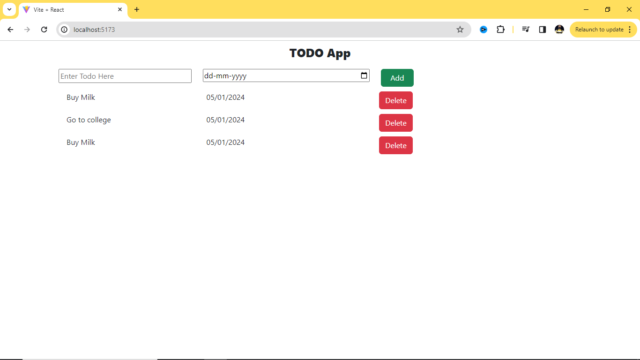
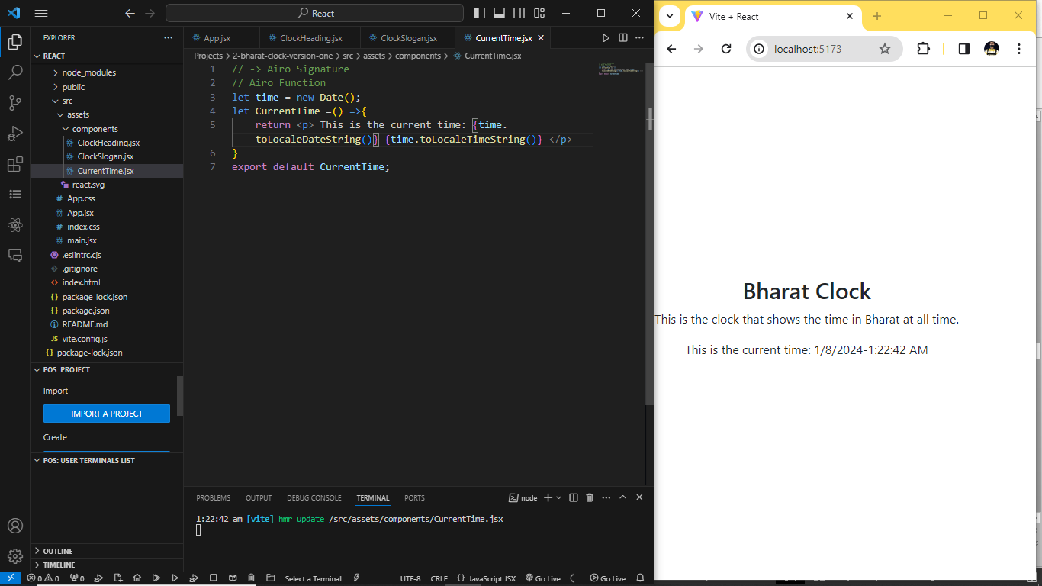
Completed App design
Second Project 2
Bharat Clock
This is the clock that shows the time in Bharat at all times.
This is the current time: 07/01/2023 – 23:38:00 PM

Slide 24
Completed App design
Second Project 2
Bharat Clock
This is the clock that shows the time in Bharat at all times.
This is the current time: 07/01/2023 – 23:38:00 PM

Slide 25
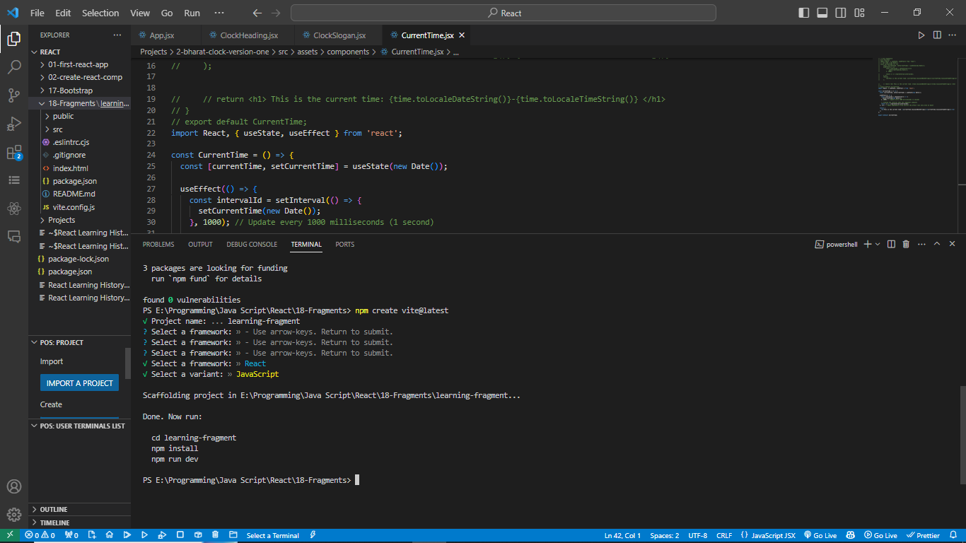
1. <React.Fragment>…</React.Fragment>
2. Short: <>…</>

Slide 26
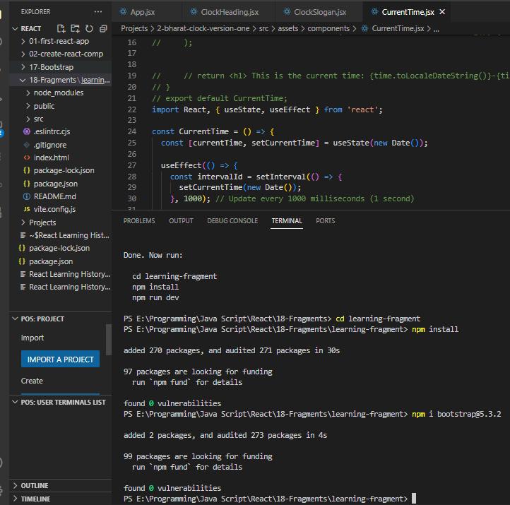

Slide 27
import React from "react";
import "bootstrap/dist/css/bootstrap.min.css"
import './App.css'
function App(){
return (
<React.Fragment>
<h1>Healthy Food</h1>
<ul class = "list-group">
<li class ="list-group-item"> An item </li>
<li class ="list-group-item"> An second item </li>
<li class ="list-group-item"> An third item </li>
<li class ="list-group-item"> An fourth item </li>
<li class ="list-group-item"> An a fifth one </li>
</ul>
</React.Fragment>
);
} export default App
import "bootstrap/dist/css/bootstrap.min.css"
import './App.css'
function App(){
return (
<div>
<h1>Healthy Food</h1>
<ul class = "list-group">
<li class ="list-group-item"> An item </li>
<li class ="list-group-item"> An second item </li>
<li class ="list-group-item"> An third item </li>
<li class ="list-group-item"> An fourth item </li>
<li class ="list-group-item"> An a fifth one </li>
</ul>
</div>
);
} export default App
Without Fragment
With Fragment
// **** start without fragment react import**********
import "bootstrap/dist/css/bootstrap.min.css"
import './App.css'
function App(){
return (
< >
<h1>Healthy Food</h1>
<ul class = "list-group">
<li class ="list-group-item"> An item </li>
<li class ="list-group-item"> An second item </li>
<li class ="list-group-item"> An third item </li>
<li class ="list-group-item"> An fourth item </li>
<li class ="list-group-item"> An a fifth one </li>
</ul>
</>
);
} export default App

Slide 28
{items.map(list => <li key={item.id}> {item.name}</li>)}
import "bootstrap/dist/css/bootstrap.min.css"
import './App.css'
function App(){
let foodList = ["Dal", "Green Vegetables", "Roti", "Milk", "Salad"];
return (
< >
<h1>Healthy Food</h1>
<ul class = "list-group">
{foodList.map(item => <li class ="list-group-item">{item} </li>)}
</ul>
</>
);
}
export default App
<div key={item.id}> {item.name} </div>

Slide 30
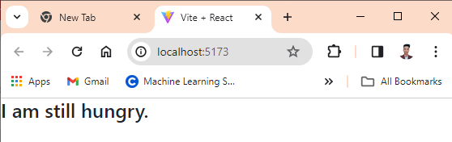
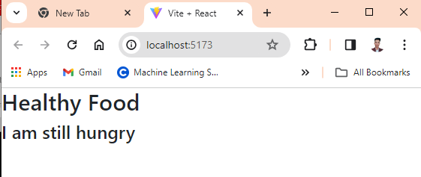
// ********** start if else condintion , condition based rander***************
import "bootstrap/dist/css/bootstrap.min.css"
import './App.css'
function App(){
// let foodList = ["Dal", "Green Vegetables", "Roti", "Milk", "Salad"];
let foodList = [];
if(foodList.length === 0){
return <h3>I am still hungry.</h3>
}
return (
< >
<h1>Healthy Food</h1>
<ul className = "list-group">
{foodList.map(item => <li key={item}className ="list-group-item">{item} </li>)}
</ul>
</>
);
}
export default App
If-else Condition
// ********** start Ternary Operator , condition based rander***************
import "bootstrap/dist/css/bootstrap.min.css"
import './App.css'
function App(){
// let foodList = ["Dal", "Green Vegetables", "Roti", "Milk", "Salad"];
let foodList = [];
return (
< >
<h1>Healthy Food</h1>
{foodList.length === 0 ? <h3> I am still hungry</h3> : null}
<ul className = "list-group">
{foodList.map(item => <li key={item}className ="list-group-item">{item} </li>)}
</ul>
</>
);
}
export default App
Ternary Operator

Slide 31
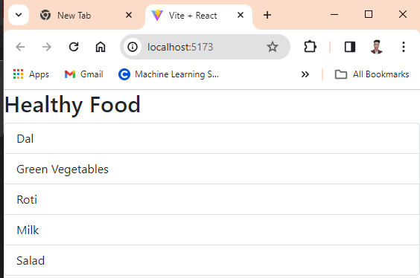
// ********** start Ternory Operator , condition based rander***************
import "bootstrap/dist/css/bootstrap.min.css"
import './App.css'
function App(){
// let foodList = ["Dal", "Green Vegetables", "Roti", "Milk", "Salad"];
let foodList = [];
let emptyMessage = foodList.length === 0 ? <h3> I am still hungry</h3> : null;
return (
< >
<h1>Healthy Food</h1>
{emptyMessage}
<ul className = "list-group">
{foodList.map(item => <li key={item}className ="list-group-item">{item} </li>)}
</ul>
</>
);
}
export default App
Array is Empty
Ternary Operator
// ********** start Ternary Operator , condition based rander***************
import "bootstrap/dist/css/bootstrap.min.css"
import './App.css'
function App(){
let foodList = ["Dal", "Green Vegetables", "Roti", "Milk", "Salad"];
// let foodList = [];
let emptyMessage = foodList.length === 0 ? <h3> I am still hungry</h3> : null;
return (
< >
<h1>Healthy Food</h1>
{emptyMessage}
<ul className = "list-group">
{foodList.map(item => <li key={item}className ="list-group-item">{item} </li>)}
</ul>
</>
);
}
export default App
Array is not Empty
Ternary Operator

Slide 32
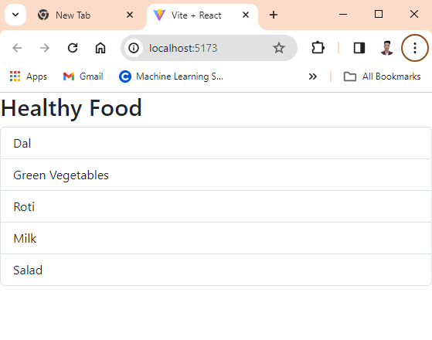
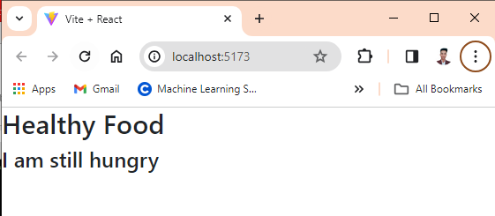
// ********** start Logical Operator (&&), condition based rander***************
import "bootstrap/dist/css/bootstrap.min.css"
import './App.css'
function App(){
let foodList = ["Dal", "Green Vegetables", "Roti", "Milk", "Salad"];
// let foodList = [];
return (
< >
<h1>Healthy Food</h1>
{foodList.length === 0 && <h3> I am still hungry</h3>}
<ul className = "list-group">
{foodList.map(item => <li key={item}className ="list-group-item">{item} </li>)}
</ul>
</>
);
}
export default App
Array is not Empty
Logical Operator (&&)
// ********** start Logical Operator (&&), condition based rander***************
import "bootstrap/dist/css/bootstrap.min.css"
import './App.css'
function App(){
// let foodList = ["Dal", "Green Vegetables", "Roti", "Milk", "Salad"];
let foodList = [];
return (
< >
<h1>Healthy Food</h1>
{foodList.length === 0 && <h3> I am still hungry</h3>}
<ul className = "list-group">
{foodList.map(item => <li key={item}className ="list-group-item">{item} </li>)}
</ul>
</>
);
}
export default App
Array is Empty
Logical Operator (&&)

Slide 33
Falsey value
Undefined
Null
Empty
Zero
Not a number

Slide 34
21/04/2024
Scaffolding project in E:\Programming\Java Script\React\task_management_app...
Done. Now run:
cd task_management_app
npm install
npm run dev
npm notice
npm notice New minor version of npm available! 10.2.4 -> 10.5.2
npm notice Changelog: https://github.com/npm/cli/releases/tag/v10.5.2
npm notice Run npm install -g npm@10.5.2 to update!
npm notice
E:\Programming\Java Script\React>npm install -g npm@10.5.2

Slide 35
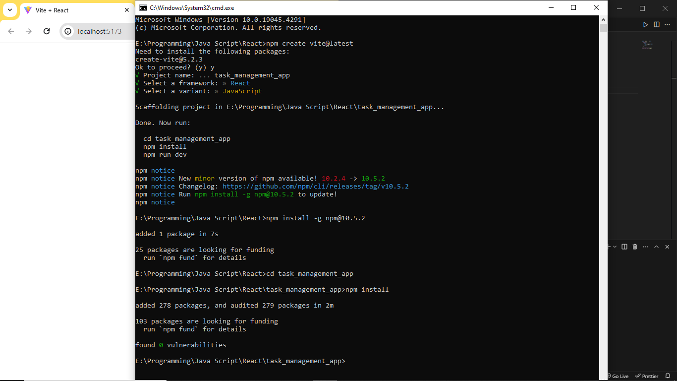

Slide 36
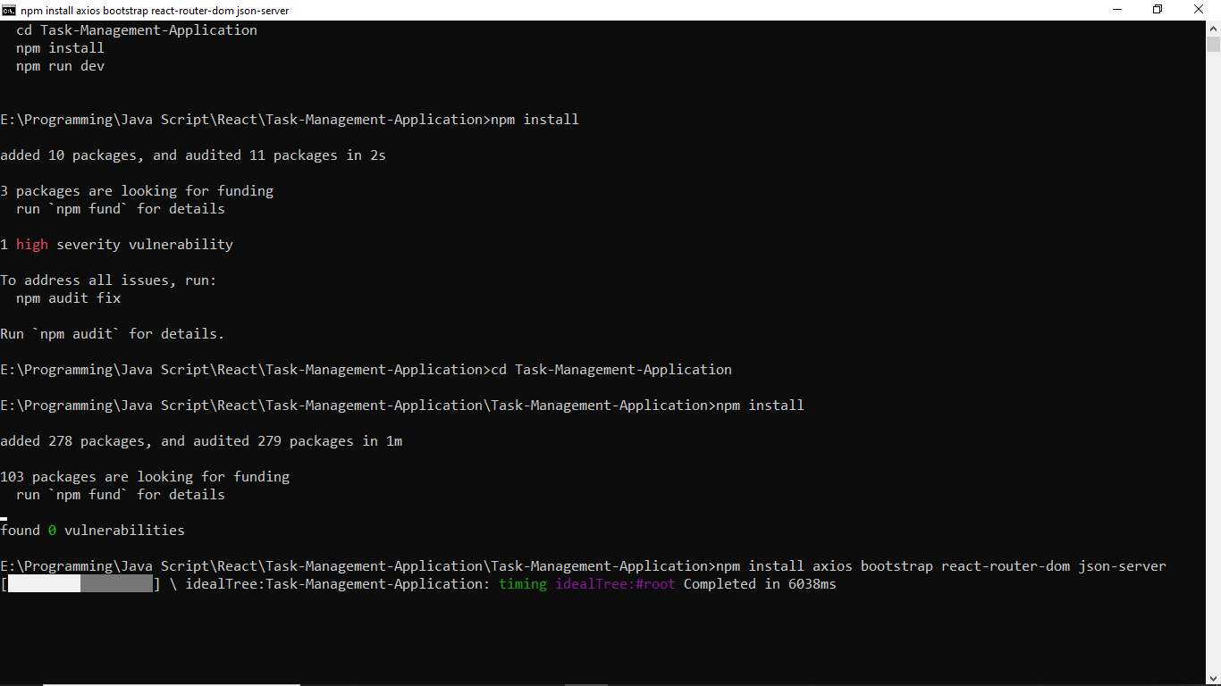

Slide 37
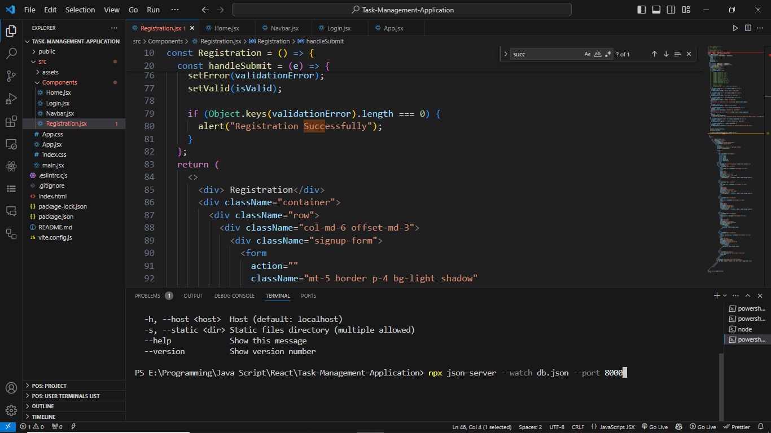

Slide 38
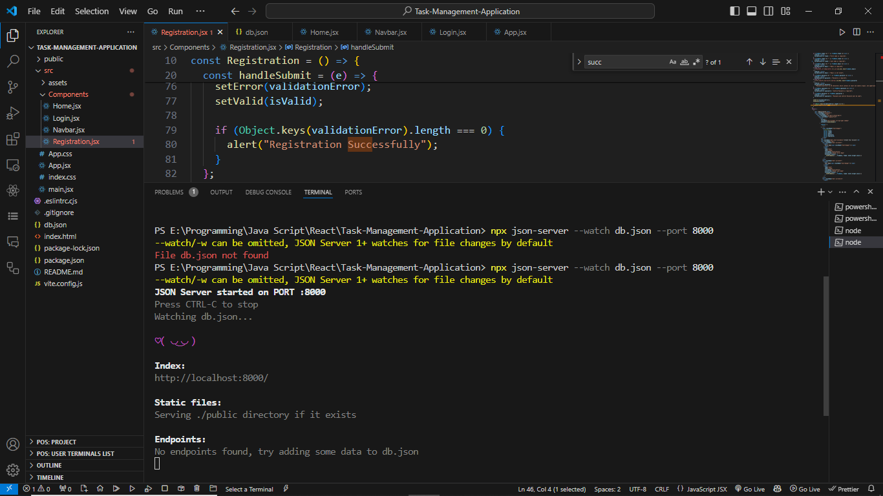

Slide 39
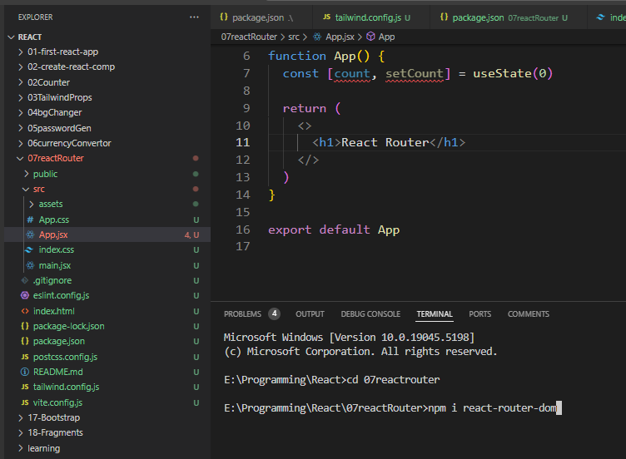
30/11/2024
React Router DOM

Slide 40
React Router Dom
22/12/2024
1. npm create vite@latest
2. cd my-project
3. npm install -D tailwindcss postcss autoprefixer
4. npx tailwindcss init –p
5. Update(tailwind.config.js)
content: [ "./index.html", "./src/**/*.{js,ts,jsx,tsx}", ],
6. Update(./src/index.css)
@tailwind base; @tailwind components; @tailwind utilities;
7. npm install react-router-dom
npm i @material-tailwind/react

